Slide 1
Customer Retention
Presentation by Deepthi Prakashan

Slide 2
Problem Statement
To build a successful e-commerce brand, it is necessary that a customer is satisfied with their purchase and had a pleasant experience during the purchase until the purchased product is delivered to the destination without any roadblocks. This will help gain a customer’s trust and build loyalty around this company.
However, lacking a good customer retention strategy and neglecting the issues faced by customers during the purchase or due the quality of the purchased product, can present as a barrier towards customer retention, thereby lagging behind in the competition against the current e-commerce stores.
To build a good customer retention strategy, we must identify which factors contribute to the success of an e-commerce store that led to building a strong customer loyalty by studying the data obtained from Indian e-commerce stores.

Slide 3
Customer Retention and why it is important?
Customer retention and building a loyal community around the brand is the end goal of every brand as it ensures longevity of the e-commerce store’s success.
Monitoring the trend and pattern of customers using analytical tools from time to time is key to understand the strategies for gaining customer loyalty.
Online purchases have their own setbacks and benefits. Understanding the setbacks and working on it can lead to the success of an e-commerce store.

Slide 4
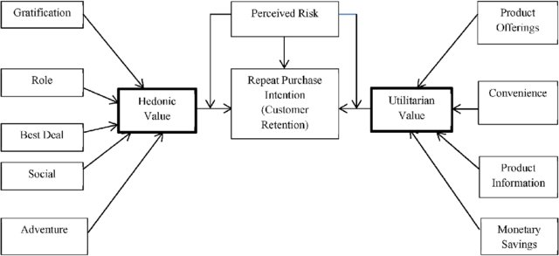
Customer Loyalty
Repurchase of items from the same brand refers to customer loyalty, which is a direct outcome of positive purchase experience.
Building customer loyalty is a combination of both utilitarian and hedonistic values.

Slide 5
Steps in EDA
Importing data
Data available as csv format from Indian ecommerce stores was imported into the Jupyter Notebook
Data Pre-processing
Checked for null values, removed duplicates and relabelled the features
Data Visualization
Univarient and Bivarient analyses were carried out to better understand the relationships that existed in the data .

Slide 6
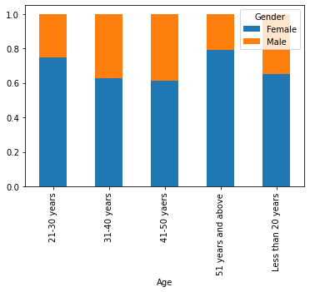
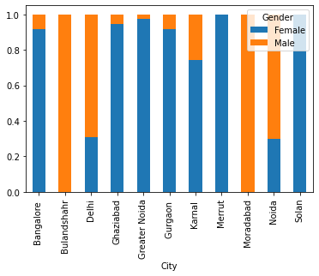
EDA
About the dataset :
Most of the people shopping from Indian are from the age group of 31 years- 40 years, majority being females.
It is seen that people online shopping are from Delhi .The respondents from Delhi are mostly men.
.

Slide 7
Majority of the respondents have been using shopping online for more than 4 years suggesting that the company does have good customer loyalty.
After their first shopping experience from theses e-commerce stores they have gone back to the site either through Search Engine or Web App, suggesting that the first shopping experience had been good enough to have downloaded the app.
The browser that customers used to accessing the site is mostly Google Engine followed by Safari
Customers first checked into the website through search engine
Percentage of people have accessed the website via the application during the next purchase is high and follows close second to Search Engine. This is mostly due to the ease of usage. Also, this proves that people found the e-commerce store good enough to have downloaded the App.

Slide 8
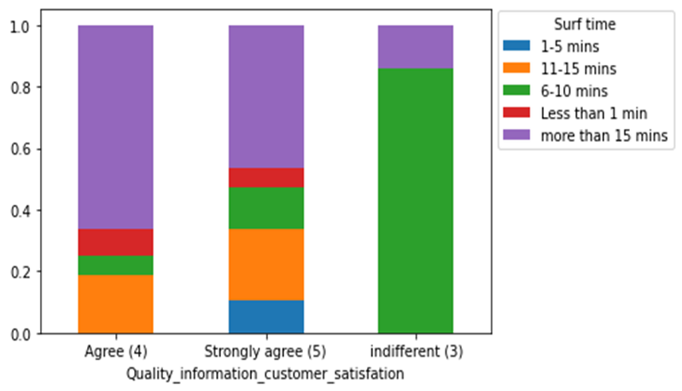
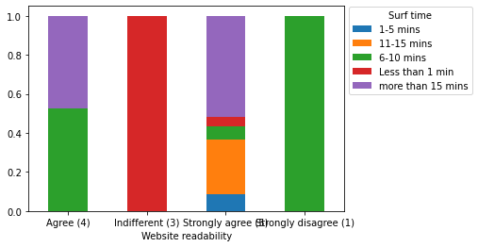
Time taken before deciding to purchase a product
Most of the users take more time before deciding to purchase a product. This is because people check through various products while also reading the product information, to feel satisfied before purchasing it
People who agree/strongly agree that website readability is important are also the same people who more time before purchasing a product. An easily understandable website is easier to navigate through and also spend time researching about the product.

Slide 9
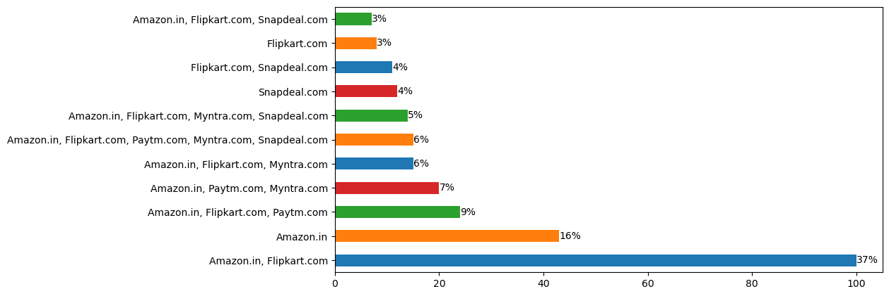
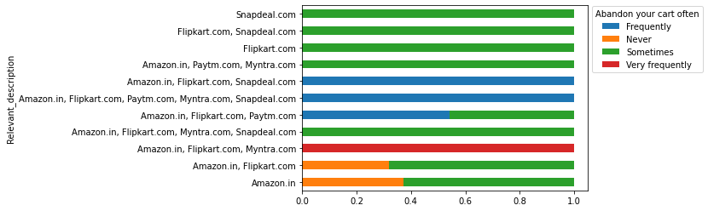
Also majority find Amazon and Flipkart to provide relevant description of the product and people are very less likely to abandon the product, because it helps trust the product better.

Slide 10
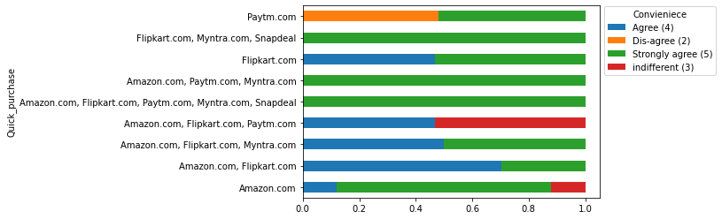
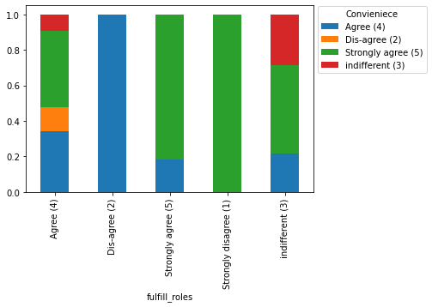
Convenience from online shopping
Online shopping is easier and convenient for shoppers for various reasons such as saving time as it allows quick purchase.
Majority people believe that it also helps save money.
The convenience and flexibility of online purchase also helps customers fulfil certain roles. Customers who strongly believe that online shopping help fulfil roles also has a good percent that agree only shopping is convenient.

Slide 11
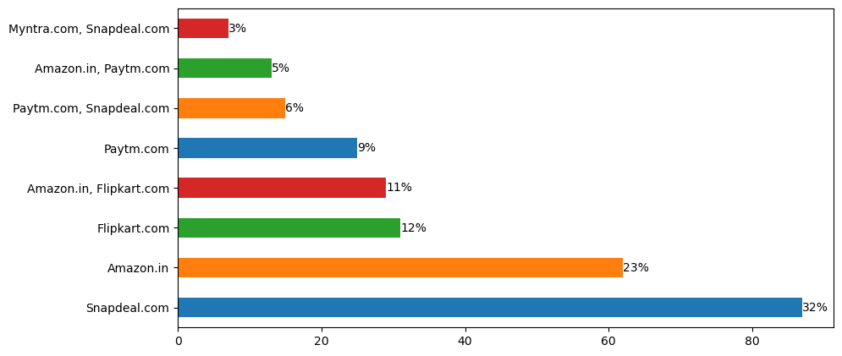
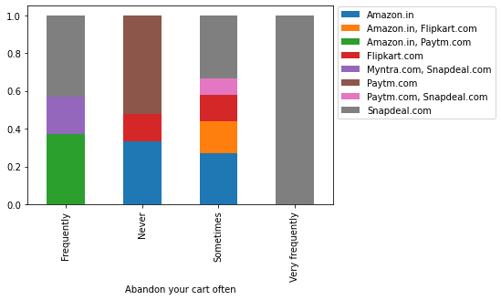
Having limited payment options for purchase can cause a lot of inconvenience to the customers.
32% of the customers found Snapdeal to lack in payment option and the same people have very frequently abandoned their cart.

Slide 12
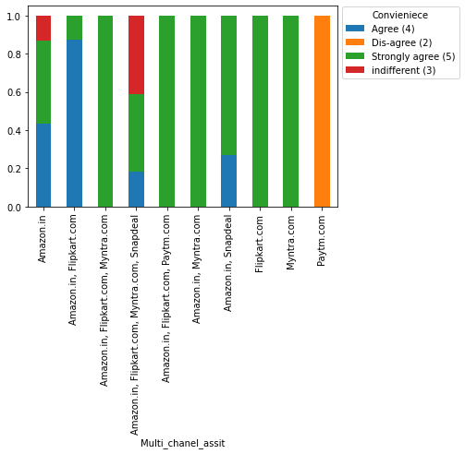
Majority purchasers agreed that Amazon, Flipkart, Myntra and Snapdeal has good presence of online assistance through multi-channel, of which majority were from people who believe convenience is important during online purchase

Slide 13
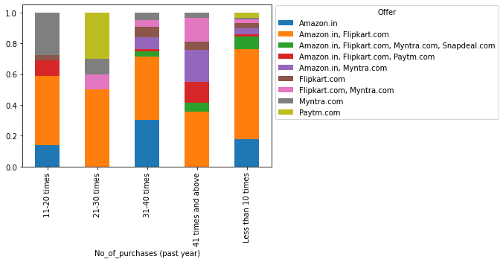
Discounts and offers
Discounts and offers are a huge attraction when is comes to pulling a crowd.
It is also seen that people have purchased more number of times in the same year when discounts and offers were provided.
A good percentage of people found wide variety of products on offer in Amazon and Flipkart also have purchased maximum number of times from the e-store.

Slide 14
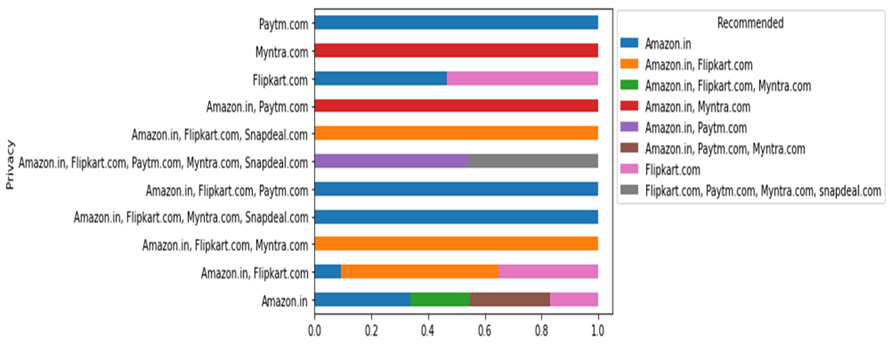
Customer Trust
One of the most essential component for people to repurchase from the same e-purchase store is through building customer trust.
Customer gains trust in a company based on many factors
Based on the analysis, amazon and flipkart were trusted by most people when it comes to protection of private information of customers, which was also recommended to other people by a good percentage of people

Slide 15
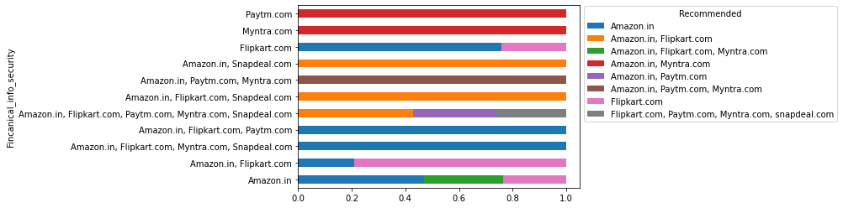
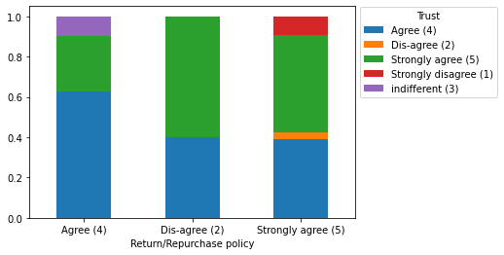
Majority people found Amazon to be a bit more reliable for financial information security and is seen to also be recommended by a sightly higher percentage of people
Purchasers who agree that trust is important for purchasing from a retailer mostly believe that the retailer’s Return/Repurchase policy is important

Slide 16
Assumption
Few assumptions made for customer retention from the analysis carried out are:
Having a detailed description about the products is very important because is gains the trust of the customer allowing them to consider the pros and cons of the product and actually buy the product.
Website that are more easier to understand and navigate through is essential which also allows quick purchase. So keeping the website easy to the eyes without much complexities is essential.
People prefer website that are more convenient when it comes to both saving money and time. Providing online assistance through multiple channels. And having multiple payment options is very essential as it allows to them select the mode they are more comfortable in.
Providing discounts on wide number of products is essential for customer loyalty.
It is essential that a company builds the gap in trust between the customer and company. by Providing, financial information security, privacy security, having a good return/repurchase policy allows them to build trust in the company.

Slide 17
Conclusion
In the project, we analysed factors that contributed the retention of customers thus impacting the success of the e-commerce stores.
Through the data analysis we saw purchasers in general prefer ease in buying product while also being sure about the quality of the product. Gaining purchasers trust when it comes to the transaction process, privacy security and financial information security is key to customer retention.
Monetary benefit also have seen resurgence of online customers.
Overall, Amazon and Flipkart had seen to be better at almost all of the aspects that contribute to the gaining customer loyalty.

